Slide 1
Topic: Linear Relationships EQ – How do I plot points on a Cartesian Plane?
Put new topic in contents page
THIS IS NOT EST CONTENT BUT WILL BE CONTENT IN TEST 2
Approximate date for test 2: Beginning of Week 9
This will be a short lesson

Slide 2
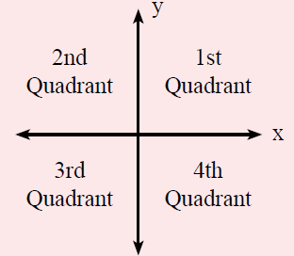

24
7
30
Topic: Linear Relationships
Date
EQ – How do I plot points on a Cartesian Plane?
What is the Cartesian Plane?
The Cartesian Plane has 4 quadrants, split up by the
___-axis (horizontal)
___-axis (vertical).
The center, where the axis meet, is called the origin.
$$Coordinates are \left(x ,y\right)$$

Slide 3
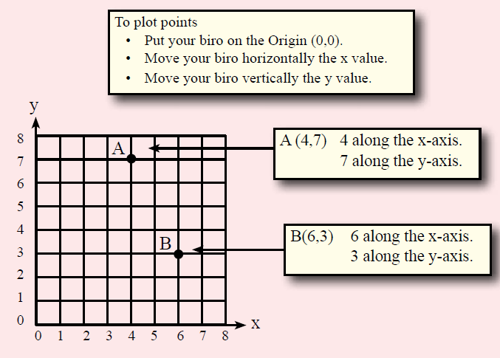
24
7
30
Topic: Linear Relationships
Date
EQ – How do I plot points on a Cartesian Plane?
How do you plot points on a Cartesian Plane?

Slide 4
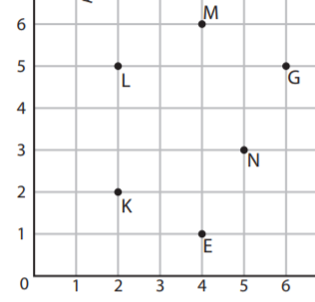
Your turn

Slide 5
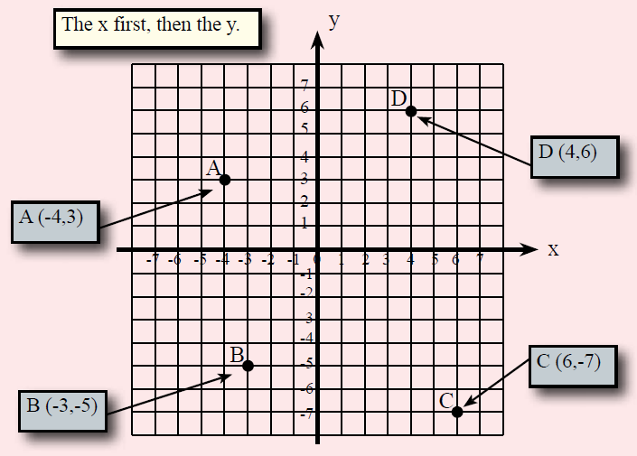
24
7
30
Topic: Linear Relationships
Date
EQ – How do I plot points on a Cartesian Plane?
How do you plot points on a Cartesian Plane?

Slide 6
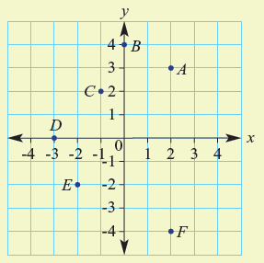

Let’s try one together
Write down the coordinates for A-F

Slide 7

Your Turn
WORKSHEETS
Left Hand Side

